Slide 1
Hiring Process Analytics
Pravesh Rana
ranapravesh30@gmail.com

Slide 2
Outline
Project Description
Approach
Tech Stack Used
Case Study - Hiring Process Analysis
Results

Slide 3
Project Description
Hiring process is the fundamental and the most important function of a company. Here, the MNCs get to know about the major underlying trends about the hiring process. Trends such as- number of rejections, number of interviews, types of jobs, vacancies etc. are important for a company to analyse before hiring freshers or any other individual. Thus, making an opportunity for a Data Analyst job here too!
Being a Data Analyst, your job is to go through these trends and draw insights out of it for hiring department to work upon.

Slide 4
Approach
Tech Stack Used
Hiring
Average salary
Class intervals
Charts and plots
Charts
Microsoft Excel

Slide 5
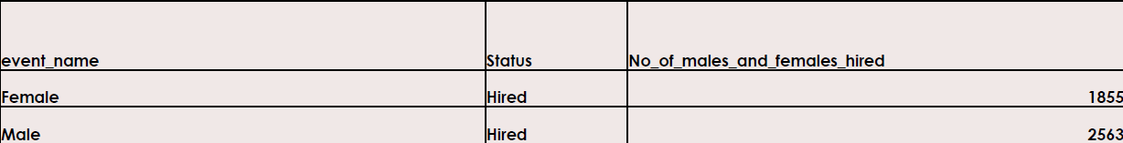
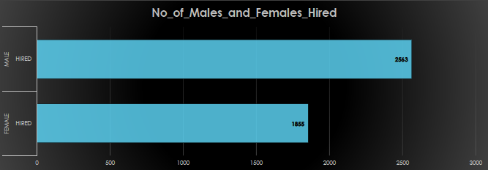
Hiring
Process of intaking of people into an organization for different kinds of positions.
Your task: How many males and females are Hired?

Slide 6
Average Salary
Adding all the salaries for a select group of employees and then dividing the sum by the number of employees in the group.
Your task: What is the average salary offered in this company?
To find the average salary offered in the company:-
First, we need to remove the outliers i.e. to remove the salaries below 1000 and above 100000
Then using the formula
=AVERAGE(entire_column_of_salary_after_removing_outliers)

Slide 7
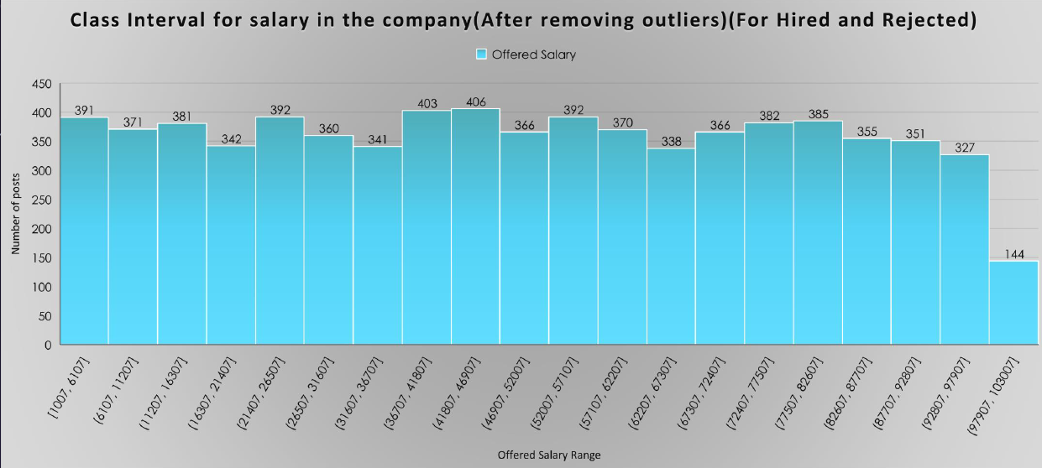
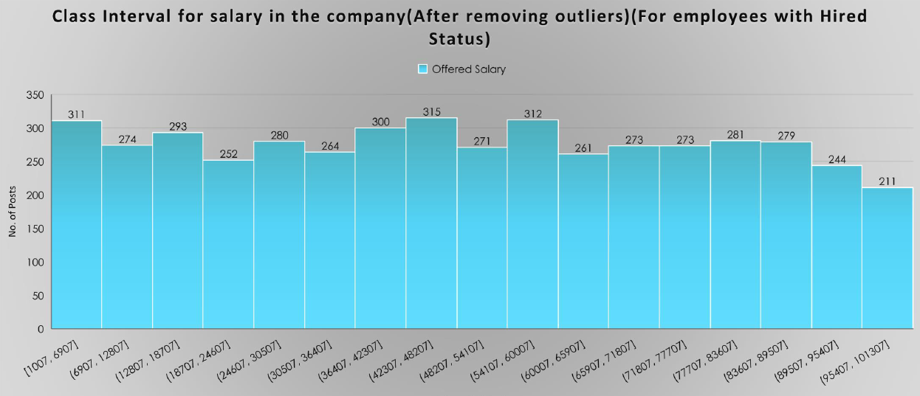
Class Intervals
The class interval is the difference between the upper class limit and the lower class limit.
Your Task: Draw the class intervals for salary in the company?

Slide 8
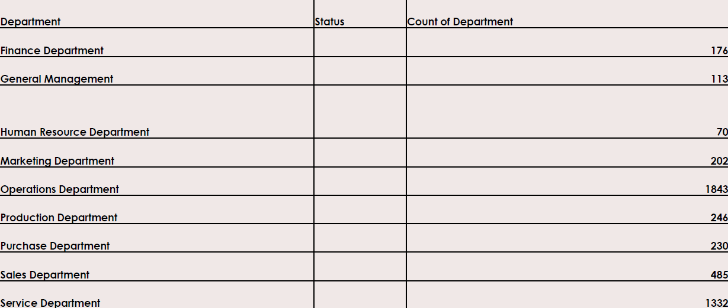
Charts and Plots
This is one of the most important part of analysis to visualize the data.
Your Task: Draw the class intervals for salary in the company?

Slide 9
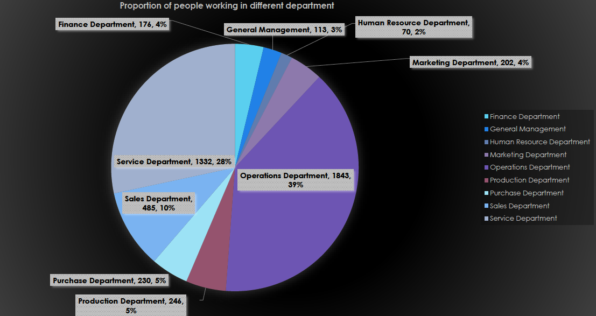
Charts and Plots
This is one of the most important part of analysis to visualize the data.
Your Task: Draw the class intervals for salary in the company?

Slide 10
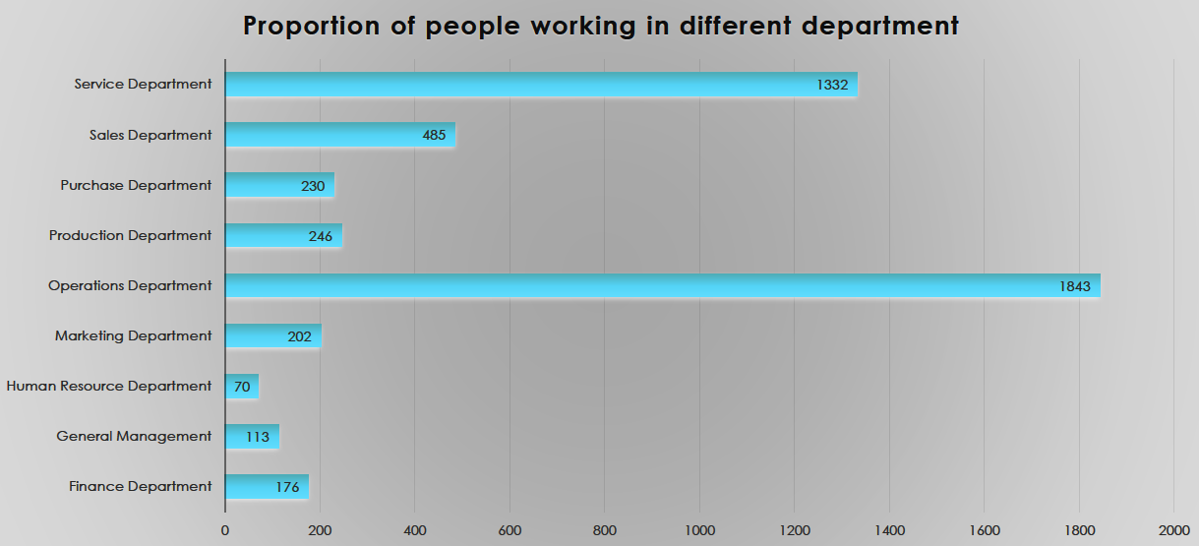
Charts and Plots
This is one of the most important part of analysis to visualize the data.
Your Task: Draw the class intervals for salary in the company?

Slide 11
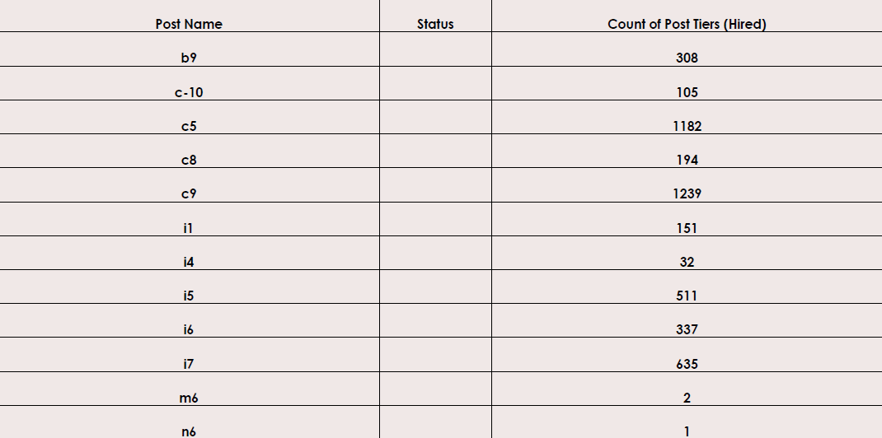
Charts (Hired)
Use different charts and graphs to perform the task representing the data.
Your Task: Represent different post tiers using chart/graph.

Slide 12
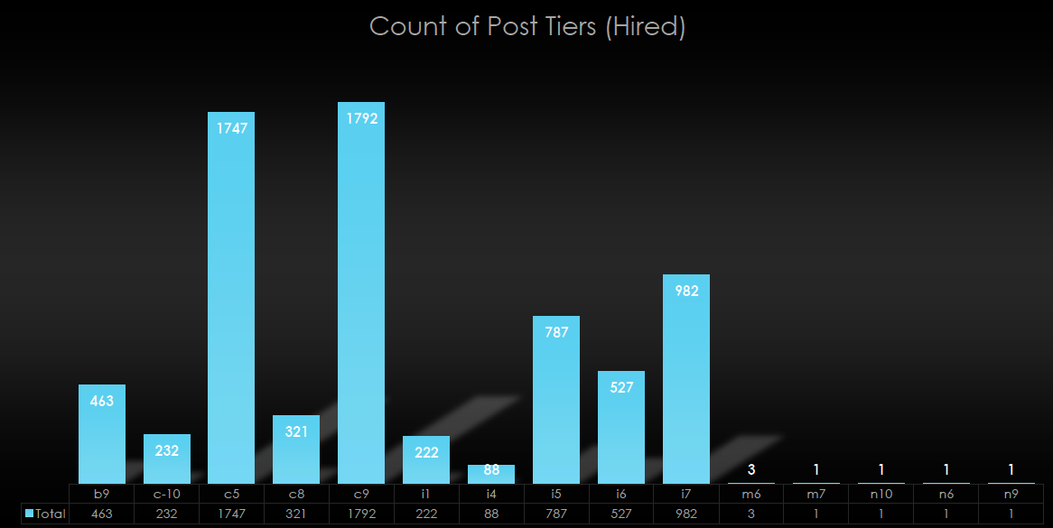
Charts (Hired)
Use different charts and graphs to perform the task representing the data.
Your Task: Represent different post tiers using chart/graph.

Slide 13
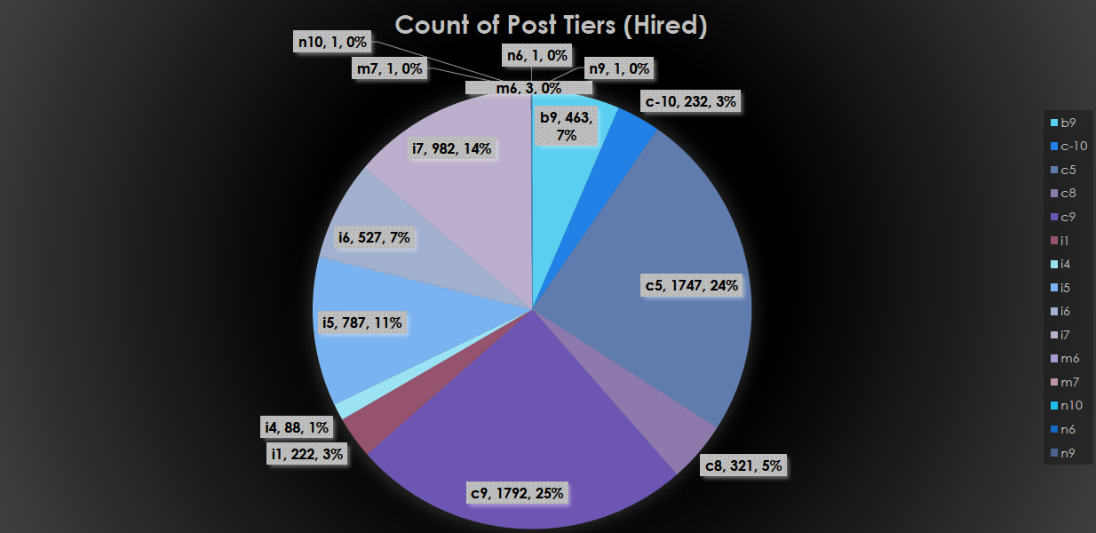
Charts (Hired)
Use different charts and graphs to perform the task representing the data.
Your Task: Represent different post tiers using chart/graph.

Slide 14
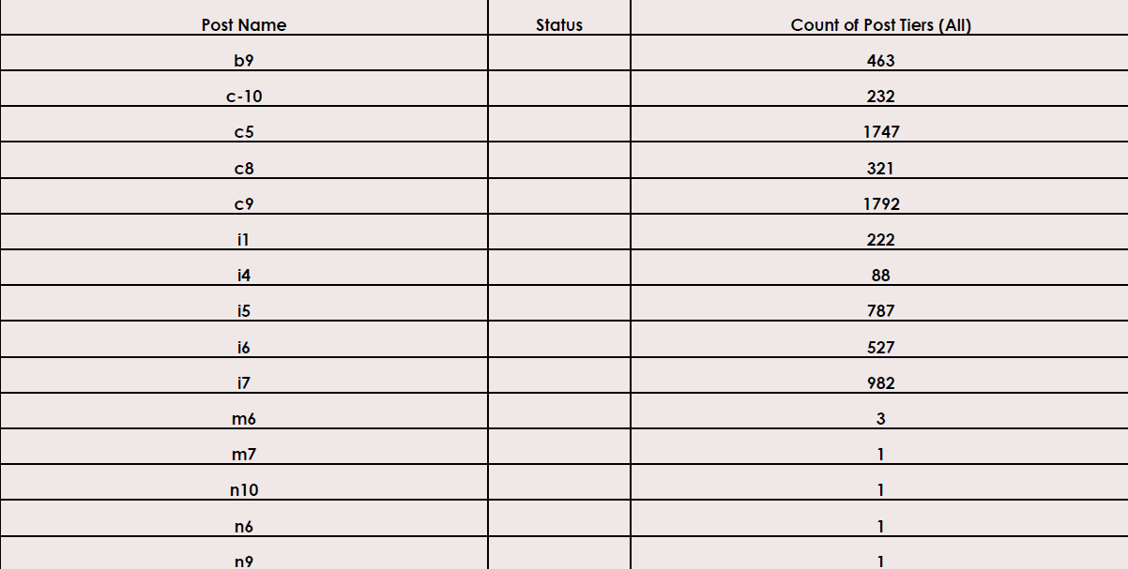
Charts (Hired+Rejected)
Use different charts and graphs to perform the task representing the data.
Your Task: Represent different post tiers using chart/graph.

Slide 15

Charts (Hired+Rejected)
Use different charts and graphs to perform the task representing the data.
Your Task: Represent different post tiers using chart/graph.

Slide 16
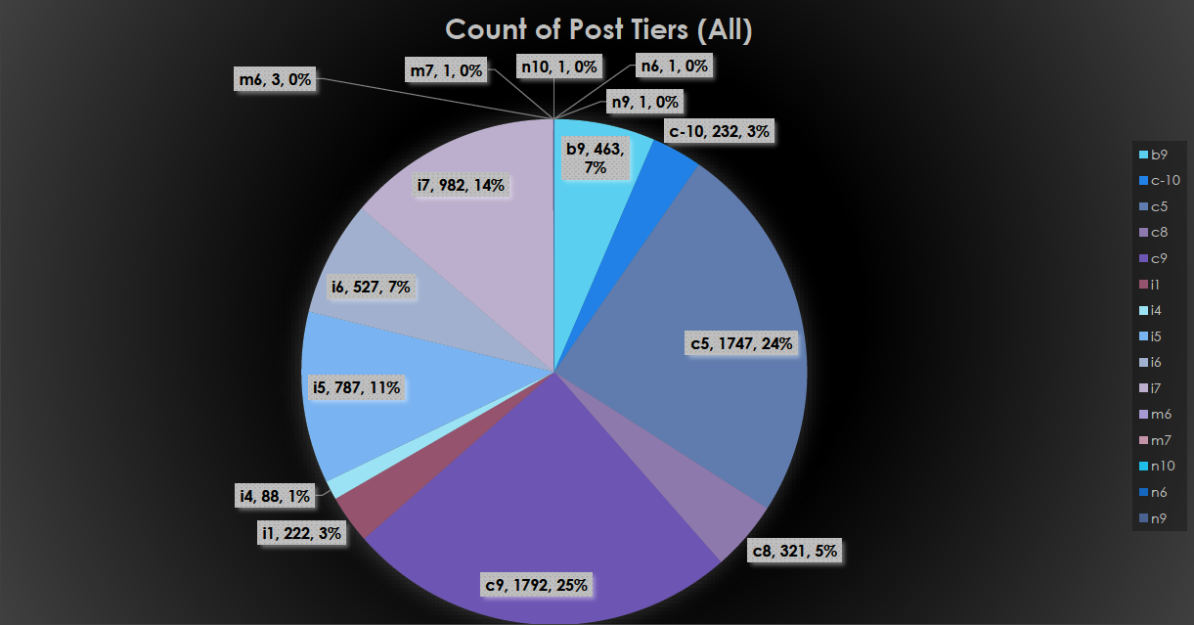
Charts (Hired+Rejected)
Use different charts and graphs to perform the task representing the data.
Your Task: Represent different post tiers using chart/graph.

Slide 17
Google Drive Link for the Updated and edited Excel https://docs.google.com/spreadsheets/d/1EQbgs4Cnl4xWUhF_51CJtocDp-bRi0Wf/edit?usp=sharing&ouid=101515825195104277499&rtpof=true&sd=true

